Slide 1
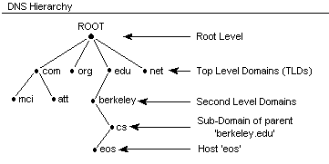
NAME RESOLUTION AND DNS
HOST FILE:The computer file hosts is an operating system file that maps hostnames to IP addresses.
DNS:
Definition of: DNS. DNS. (Domain Name System) The Internet's system for converting alphabetic names into numeric IP addresses. For example, when a Web address (URL) is typed into a browser, DNS servers return the IP address of the Web server associated with that name.
LMHOST FILE:The LMHOSTS file is a static, local database file that maps NetBIOS names to IP addresses. This is similar in functionality to the Hosts file .
WINS: Windows Internet Name Service (WINS) is Microsoft's implementation of NetBIOS Name Service . DNS is to domain names — a central mapping of host names to network addresses.
DNS HIERARCHY:DNS Hierarchy. DNS uses a hierarchy to manage its distributed database system. The DNS hierarchy, also called the domain name space, is an inverted tree structure, much like
e-Directory. The DNS tree has a single domain at the top of the structure called the root FILE.

